Slide 1


Slide 2
WELCOME TO OUR TOWNHALL.
SPONSORED BY FRIENDS OF VIRGINIA BEACH NATIONAL

Slide 3
Rob Valentine

Slide 4
What is Friends of Virginia Beach National?
How did we start?

Slide 5
Possible sale of VBN
Attended a council meeting
Member of VBN for over 10 years.
June 18, FOIA on Facebook
The Honorable Chris Taylor
Venkat and Usha Eleswarapu
2 people involved in (RFP) process that were not chosen
Take action to educate the public

Slide 6
June 29, 2026
Town Hall on July 6
Social Media Influencers, Email
Expanded our group
This is not just a VBN issue, it's bigger
July 14 CC deferment of the vote
August 1, 2026, to unite, create, and represent a larger voice for our community

Slide 7
Eagles on VBN?

Slide 8
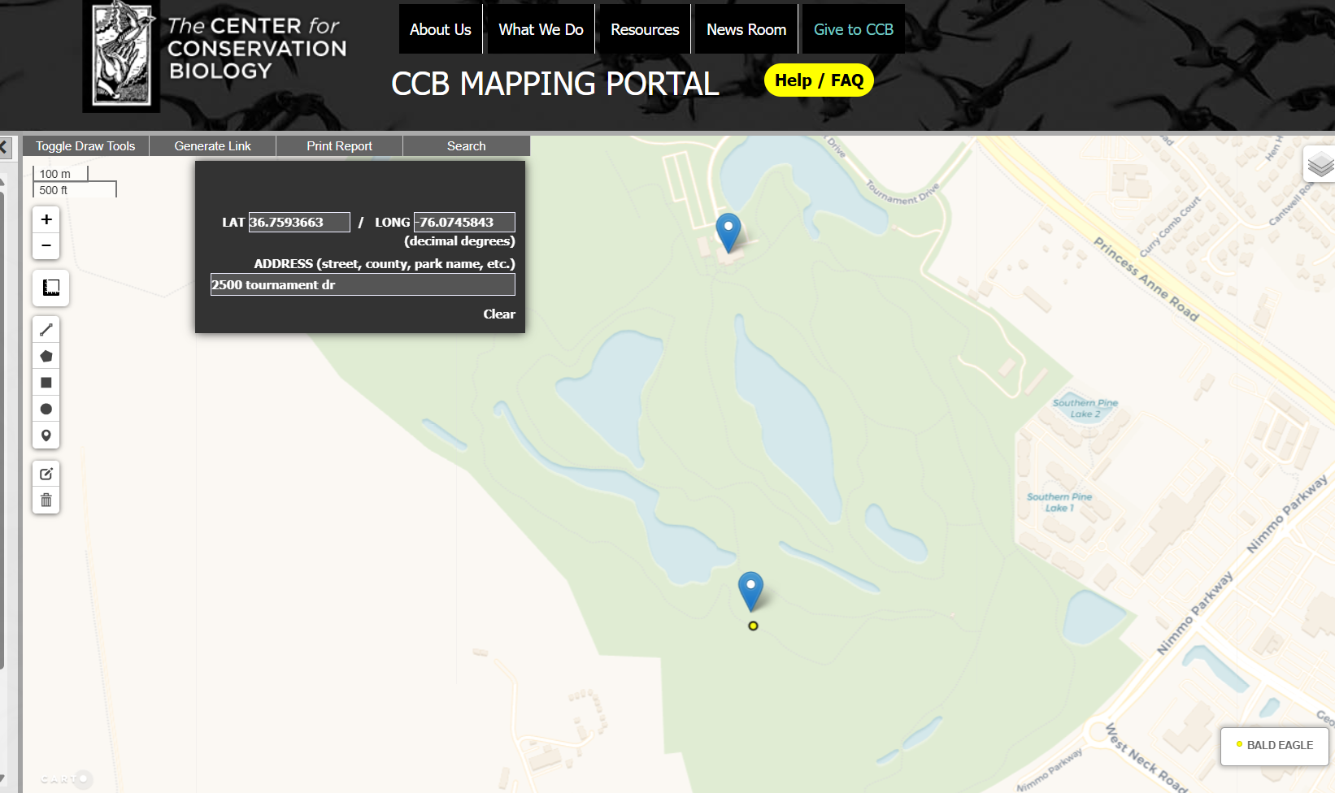

Slide 9
The Friends of Va. Beach National believes in 4 Core Tenets;
Non-Political
Accountability:
  Focuses on responsible stewardship of city leadership, evaluating areas for improvement, and providing practical solutions to the city.

Slide 10
3. Community Engagement:
  Emphasizes building strong, healthy relationships and actively engaging residents to move the city forward together.
4. Transparency:
  Highlights clear standards openness regarding goals and the processes used to achieve them, so everyone stays informed.

Slide 11
Our Goal Tonight
Provide you with information
Cause you to pause and consider;
  Does this pass the "Sniff Test"?
  Was it fair and equitable?
  Does it make sense?
  Should we be concerned?
  Is this important enough for me?

Slide 12
What Can You D0?
We Strongly encourage you to;
  At the very least, Show up Tuesday night
  Exercise your right to speak

Slide 13
TIMELINE
Dragas
City Council Members
VBED
VBDA
City Manager
City Attorney
Communications on VBN
Emails from April 29, 2024 to Sept. 18, 2024

Slide 14
April 19, 2024
16 months prior to notifying all
City Council Members
of an unsolicited Proposal from
Helen Dragas, the CEO and President of The Dragas Companies

Slide 15
July 18, 2024
Email from Charles Rigney to City Attorney Alexander Stiles and Amanda Jarratt.
He received an email and phone call from Helen Dragas asking to keep their discussion confidential.
Mr. Rigney also states it would require a redesign and movement of several holes, but it would “check down several boxes for us if we play our cards right”.

Slide 16
July 29, 2024
Email from Amanda Jarratt, Deputy City Manager to City attorney Alexander Stiles and VBED Deputy Director Emily Archer saying that after speaking with Helen Dragas, they can move on with an NDA

Slide 17
Aug 13, 2024
Email from City Attorney Stiles confirming Signed NDA between City Manager Patrick Duhaney and Helen Dragas

Slide 18
Aug 27, 2024
Email from Drew Vakos, Vice President of Business Development for The Dragas Companies, to Mac Weaver, Vice President of Business Development and Asset Management for The Dragas Companies and Amanda Jarratt, Deputy City Manager
This email has an attachment with a list of documents that Dragas requests. This is just 20 days after the signing of the NDA

Slide 19
September 17, 2024
Emily Archer, Deputy Director of VBED sends an email to Helen Dragas and Drew Vakos.
This email provides a sharable folder with all documents provided to The Dragas Companies as requested via the email from August 27

Slide 20
September 23, 2024@ 3:35 (First known contact to Council Members directly.)
Helen Dragas sends a text to Micheal (Berlucci, District 3 Councilman). She asks him if there is any chance he has any availability tomorrow after 10am to meet with her and Drew Vakos (Vice President of Business Development for The Dragas Companies). “This is regarding a large exciting project we’ve been exploring in Virginia Beach”.
Michael responds if they could meet at 1pm at city hall.
Helen responds that works for them....see you then

Slide 21
September 23, 2024@ 354pm
(20 minutes after texting Michael(Berlucci)
First text message from Helen Dragas to Rosemary and Bob, our Mayor and Vice Mayor. Helen wants to know if the three of them could meet prior to Tuesday as she has "an exciting proposal to discuss before your next council meeting".

Slide 22
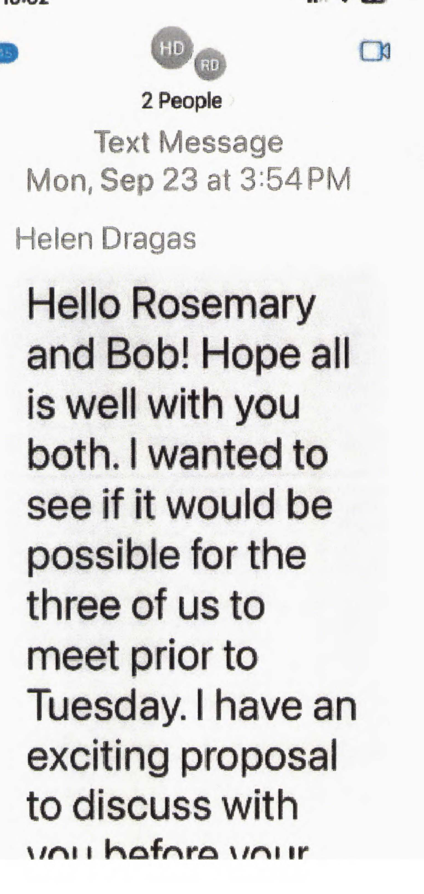
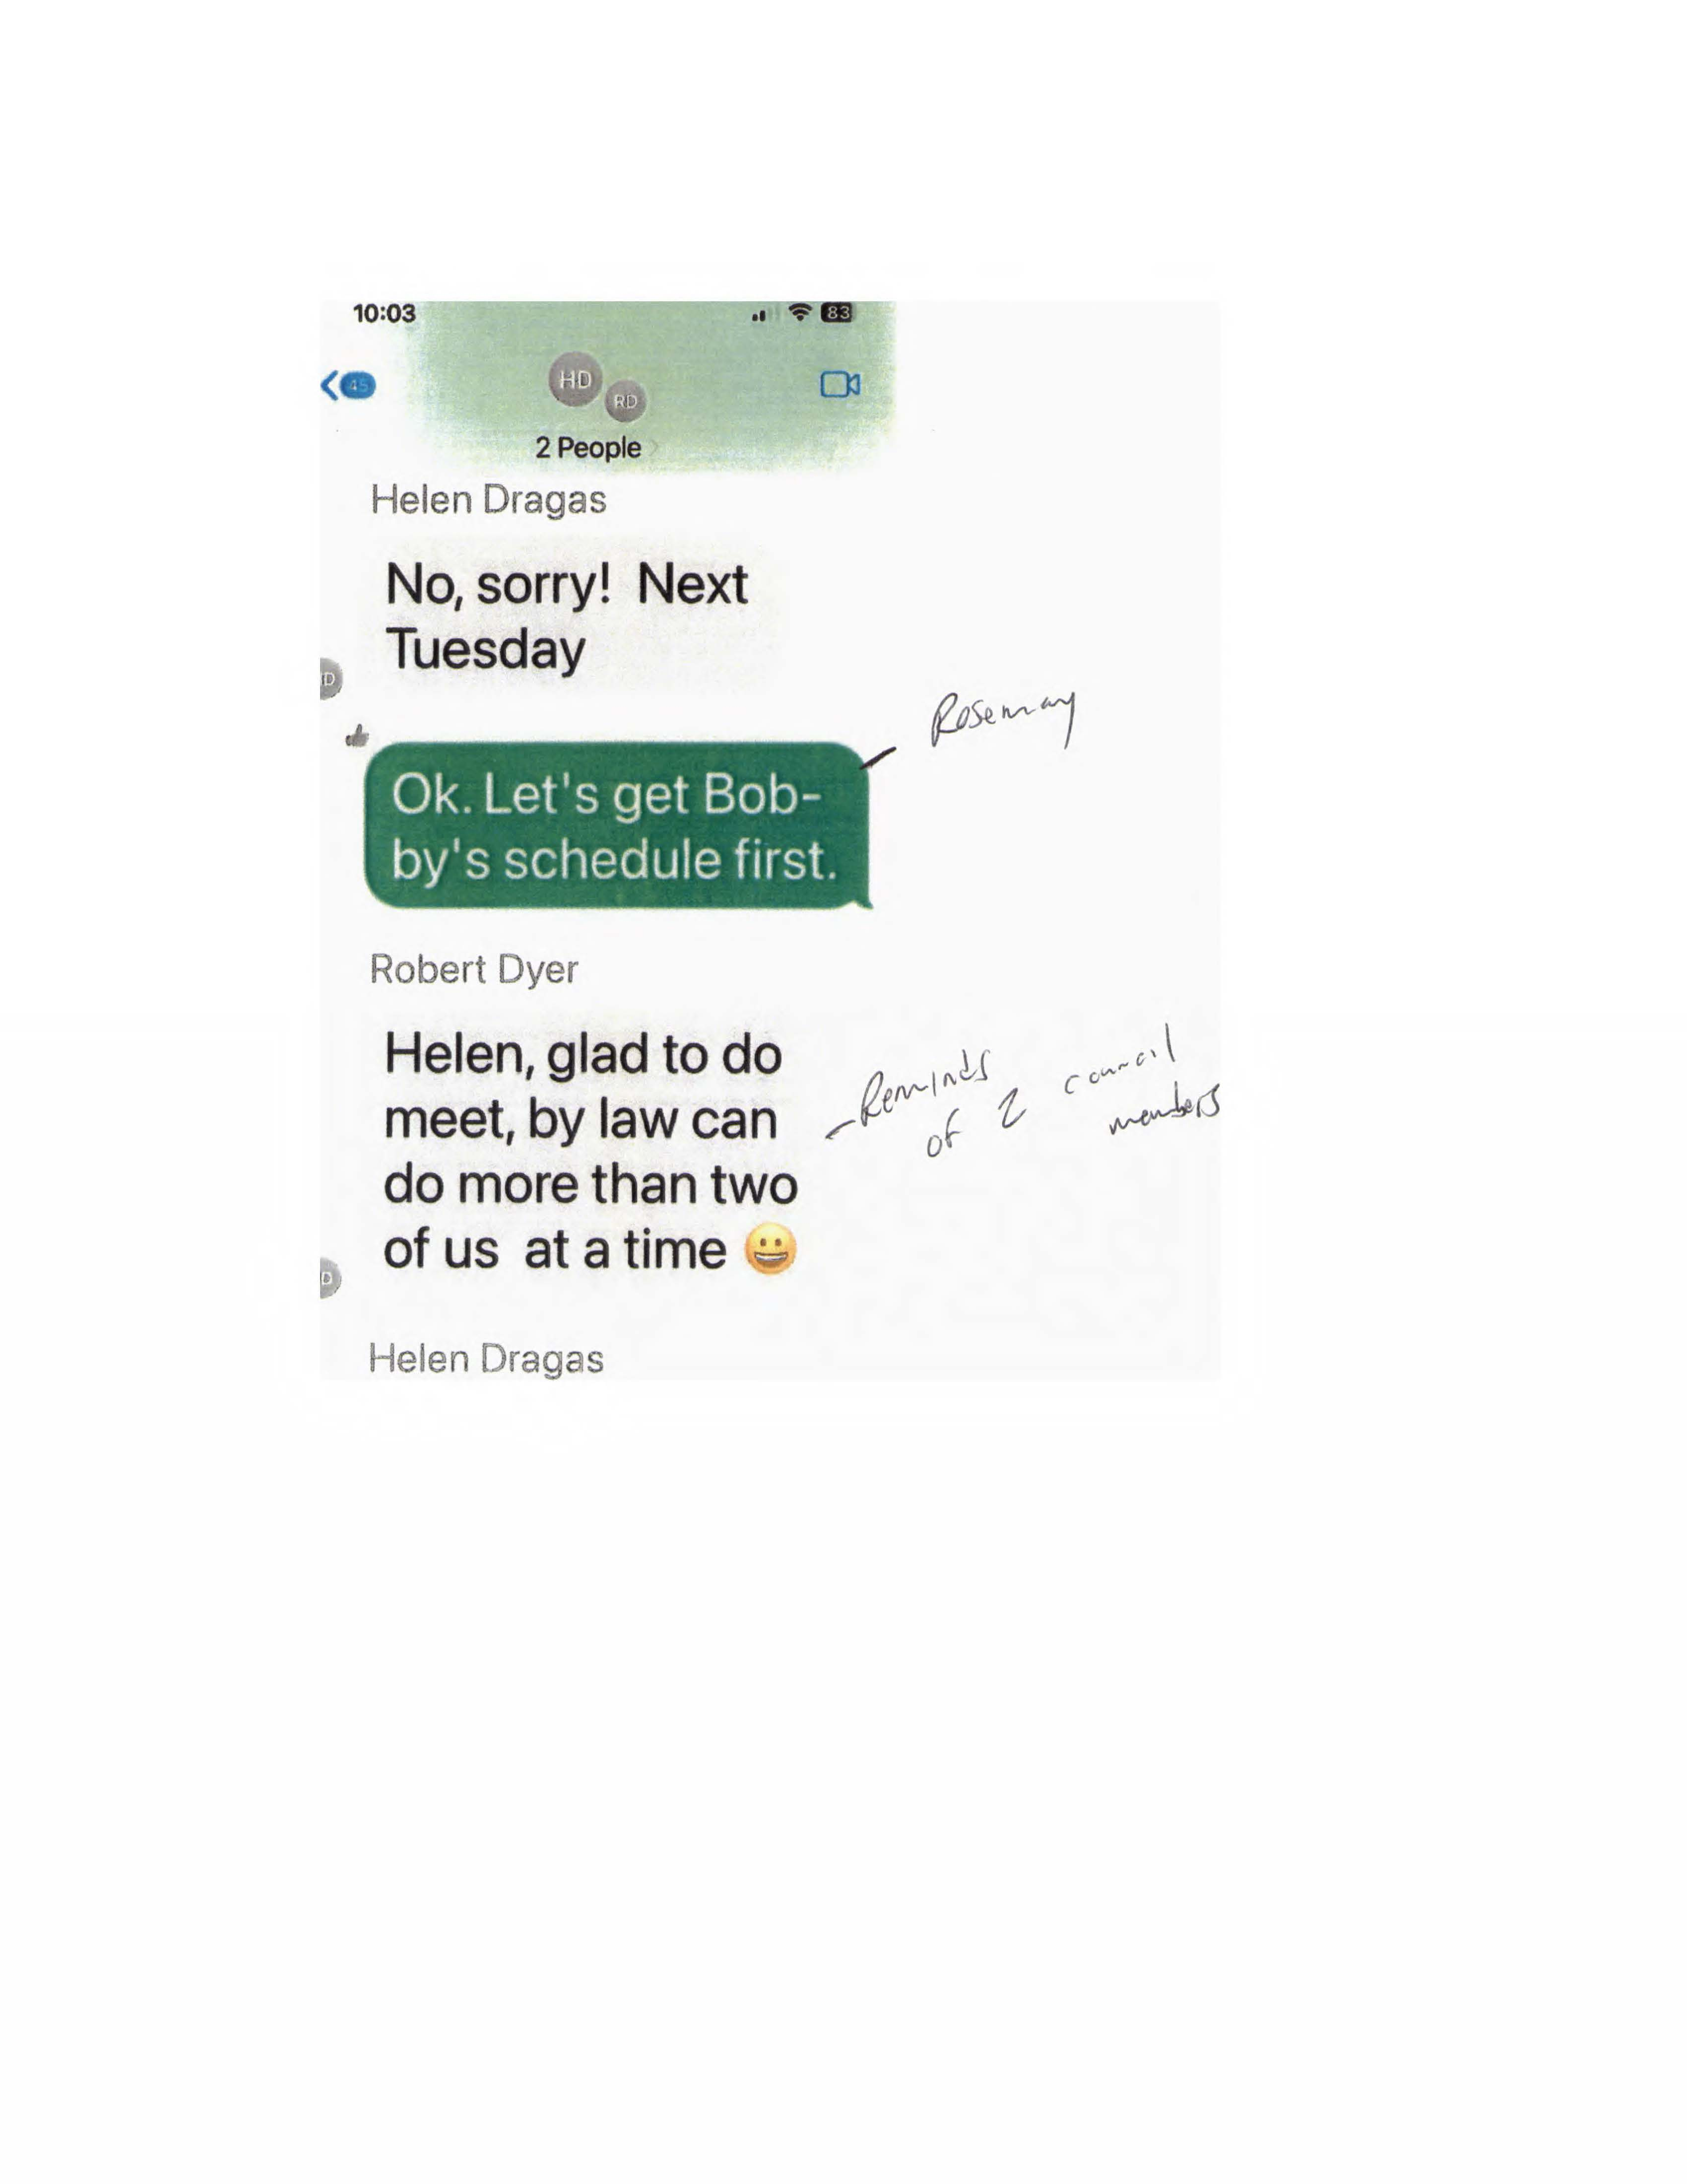
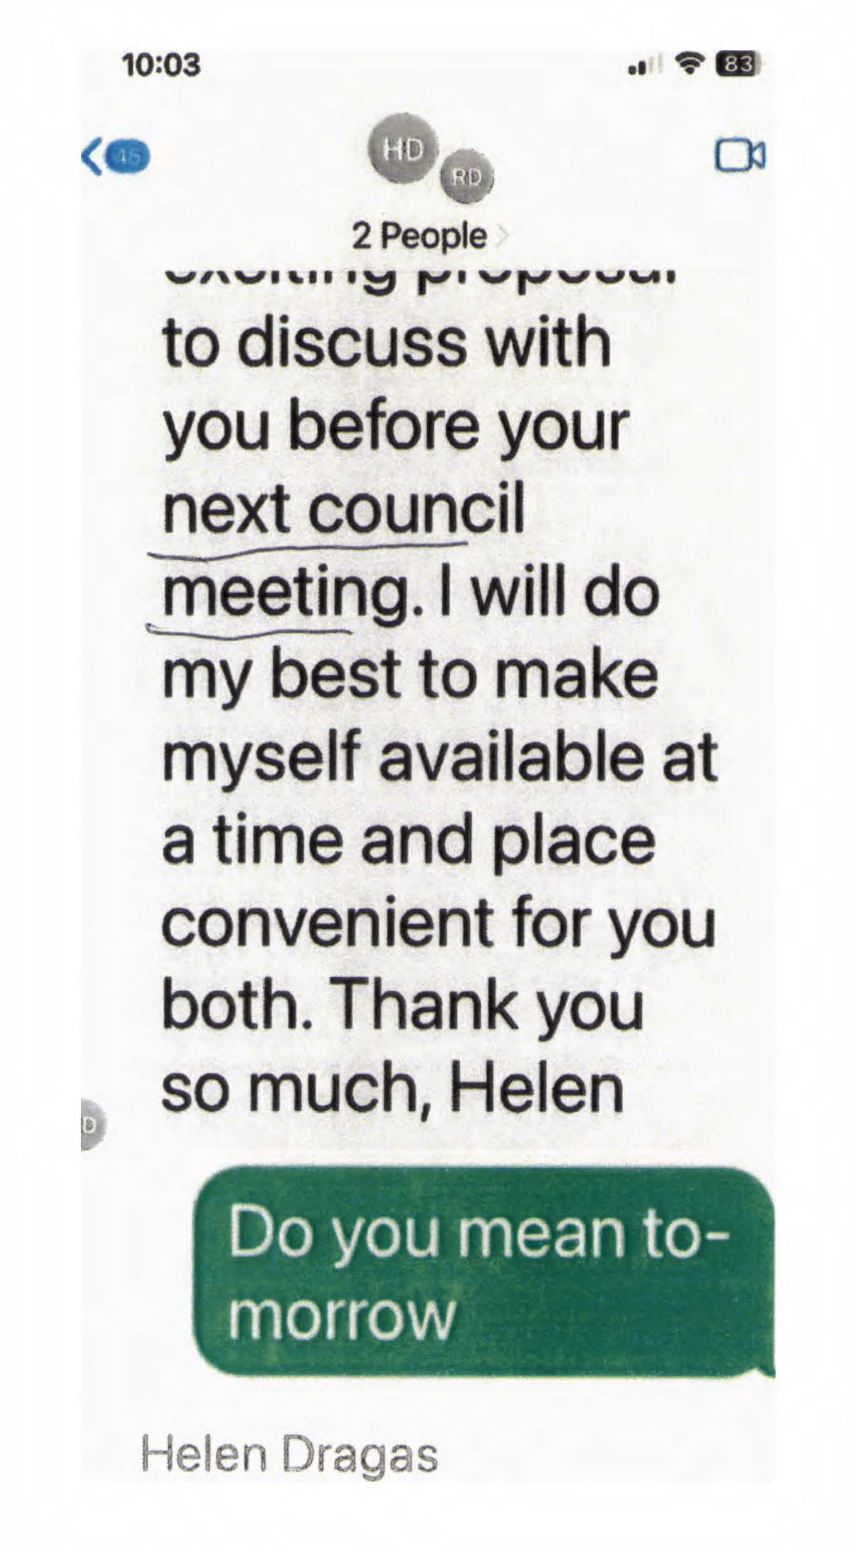
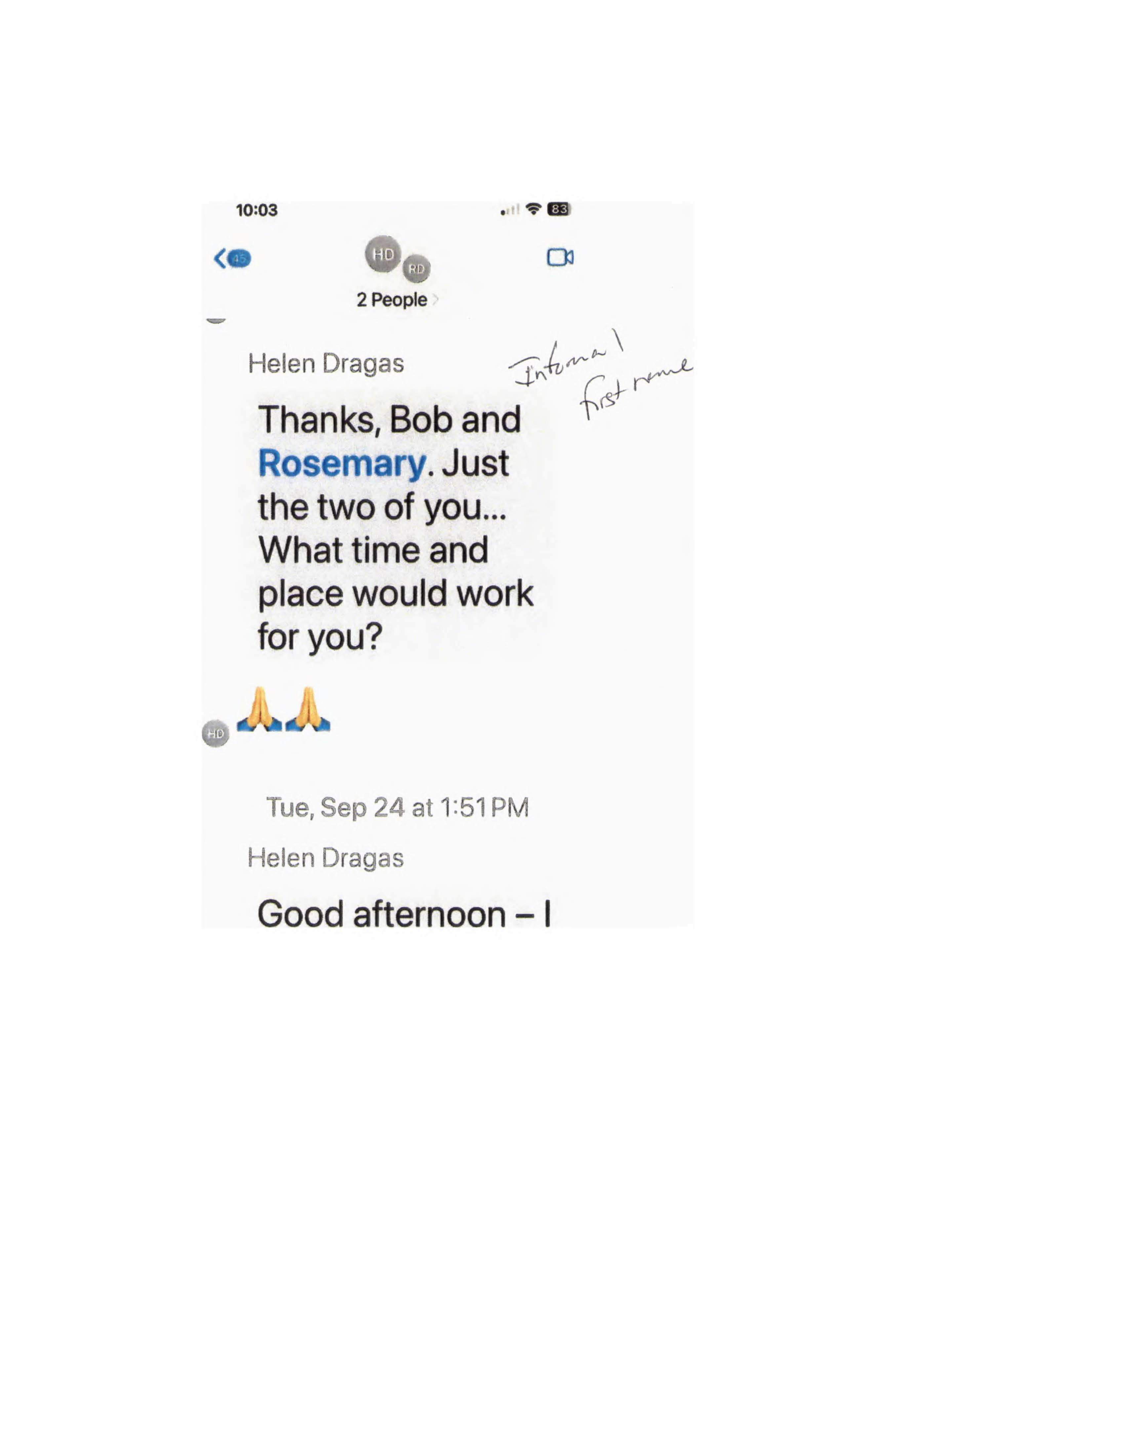

Slide 23
September 24, 2024
Texts continue between Helen, Bob and Rosemary... Our Mayor and Vice Mayor. They continue to text throughout the day as Helen Dragas asks for a time and place to meet and Rosemary suggests Friday the 27th at 10am. Rosemary says the meeting can take place in the Mayor's office.

Slide 24
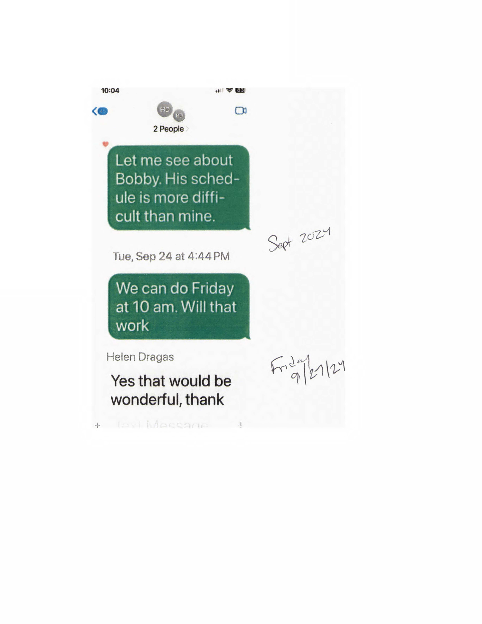
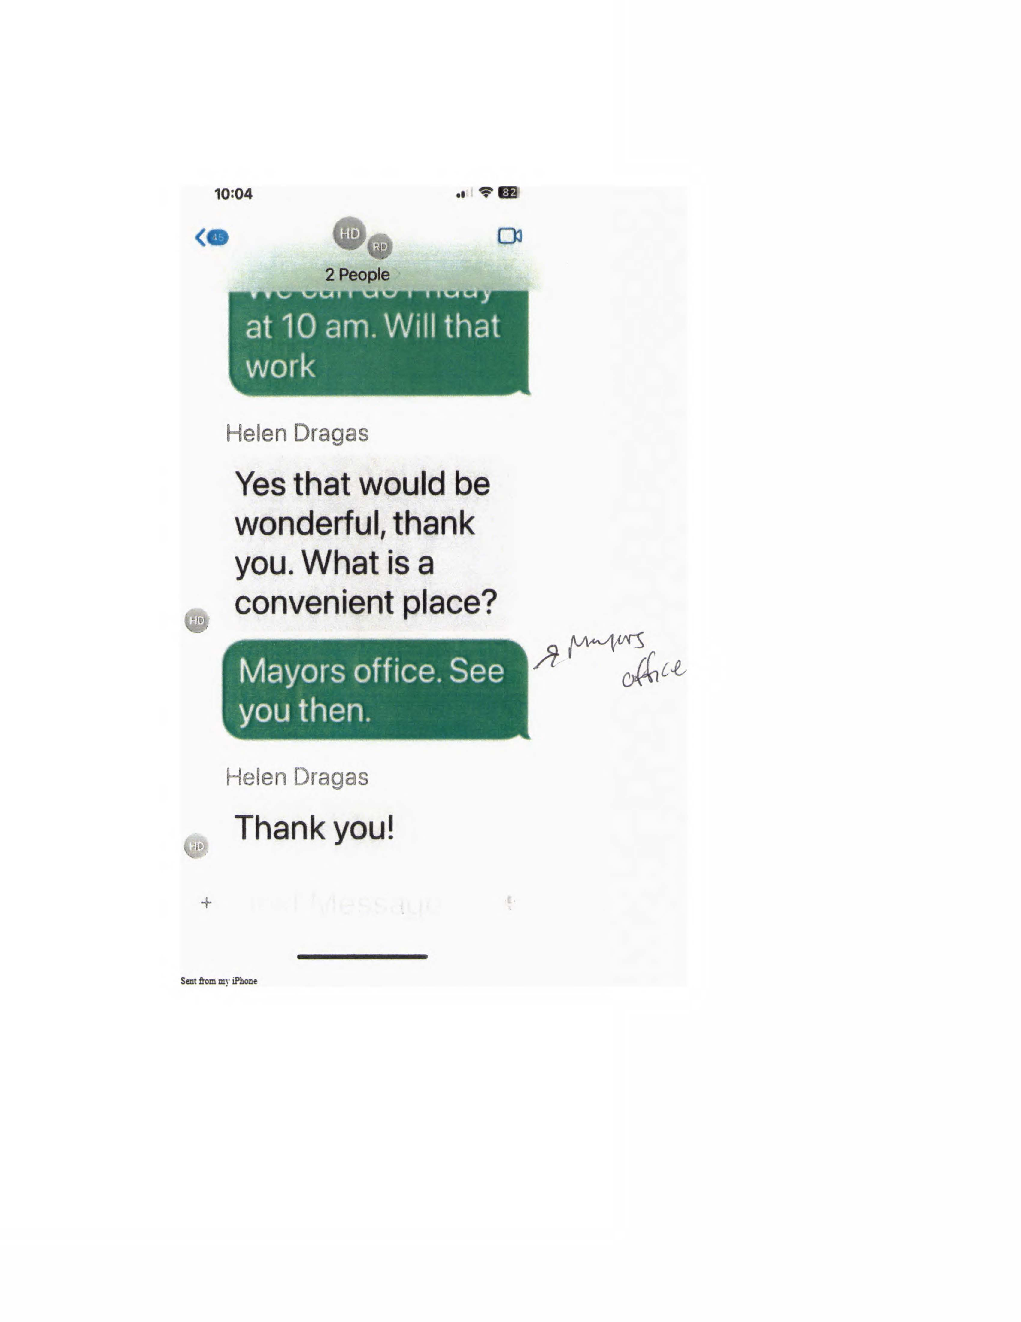
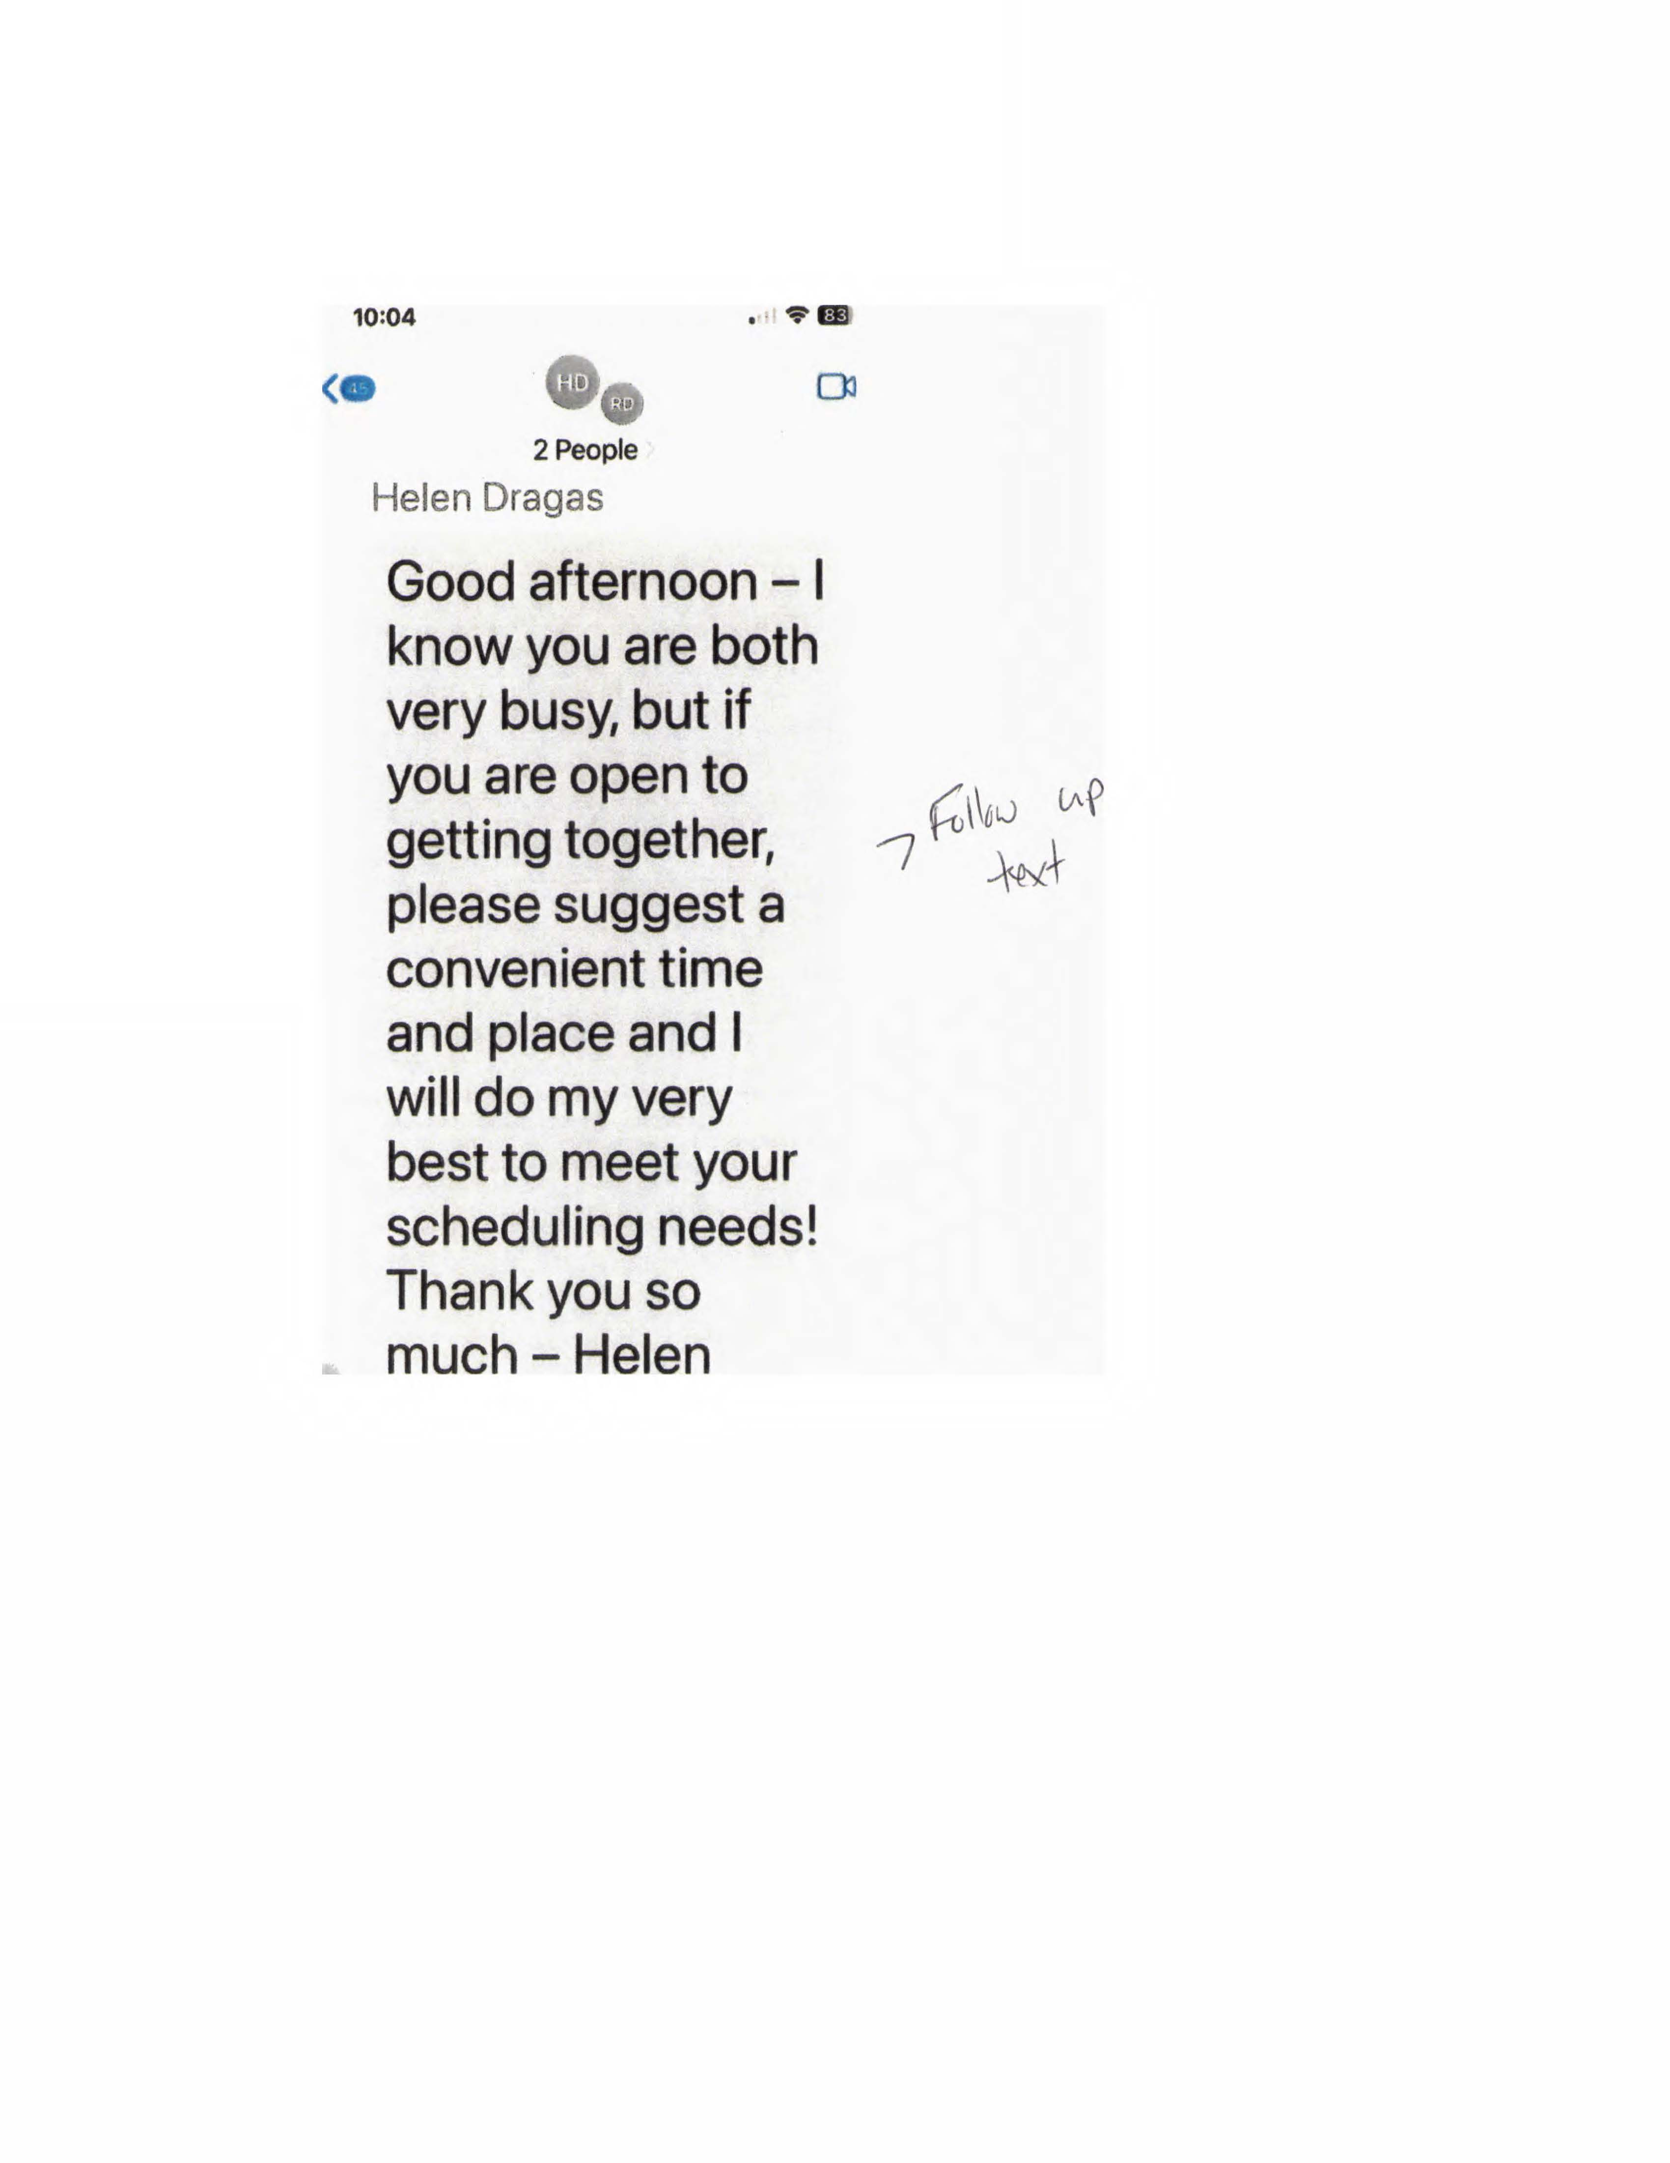

Slide 25
August of 2025 – A letter from City Manager Patrick Duhaney to all City Council Members stating that an unsolicited proposal had been received concerning the sale of VBN.
September 2, 2025 - Closed City Council Session where City Council authorizes an RFP, Request for Proposal.
October 2025 - RFP widely advertised for 45 days seeking proposals to acquire and maintain a publicly accessible 18-hole course
November 2025 - Nine (9) responses received, 4 with a housing
component, and 5 for new golf course operations
December 2025 to January 2026 – Four (4) shortlisted respondents
identified after a Review Committee convened and Council closed
briefings, 2 with a housing component and 2 for new golf course
operations
January to February 2026 - Interviews conducted
February 2026 – City Council authorized negotiation of a term sheet with the top-ranking respondent

Slide 26
THAT TOP-RANKING RESPONDENT IS?

Slide 27
The Dragas Companies
This proposal gives Dragas approximately
$36 million dollars to develop

Slide 28
Virginia Beach National Golf Course Selection Committee
Alex Stiles - Senior City Attorney
Amanda Jarratt - Deputy City Manager
Kathy Warren - Director of Planning
Carrie Bookholt - Deputy Director of Planning
Emily Archer - Acting Director of Economic Development
Natalie Guilmeus - Deputy Director of Economic Development
Pam Witham - Senior Planner with Economic Development
Kevin Chatelier - Director of Budget Management Services

Slide 29
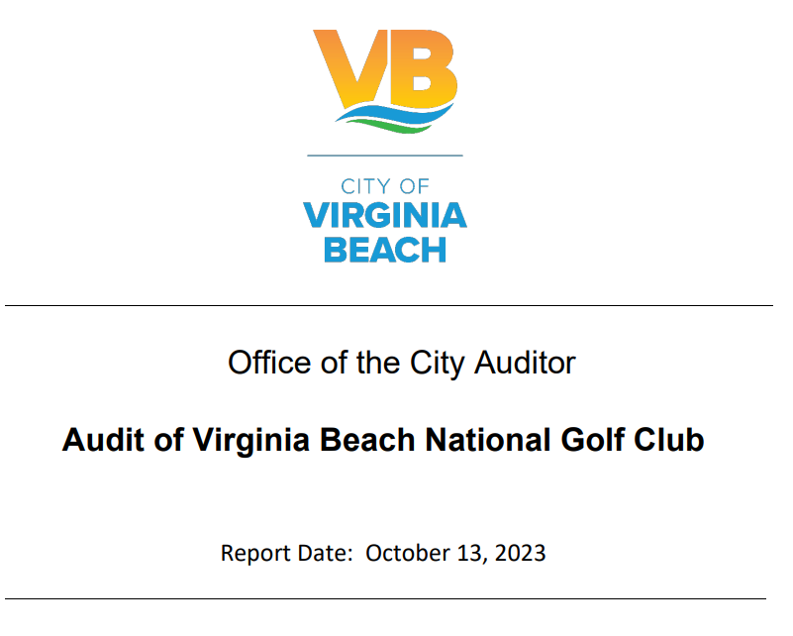

Slide 30
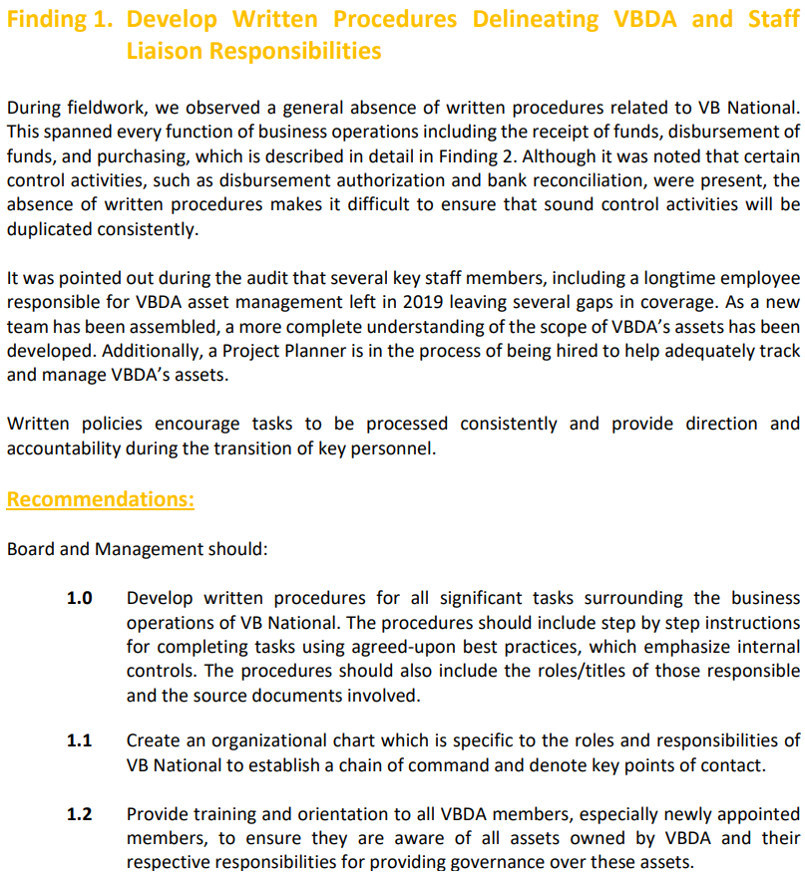

Slide 31
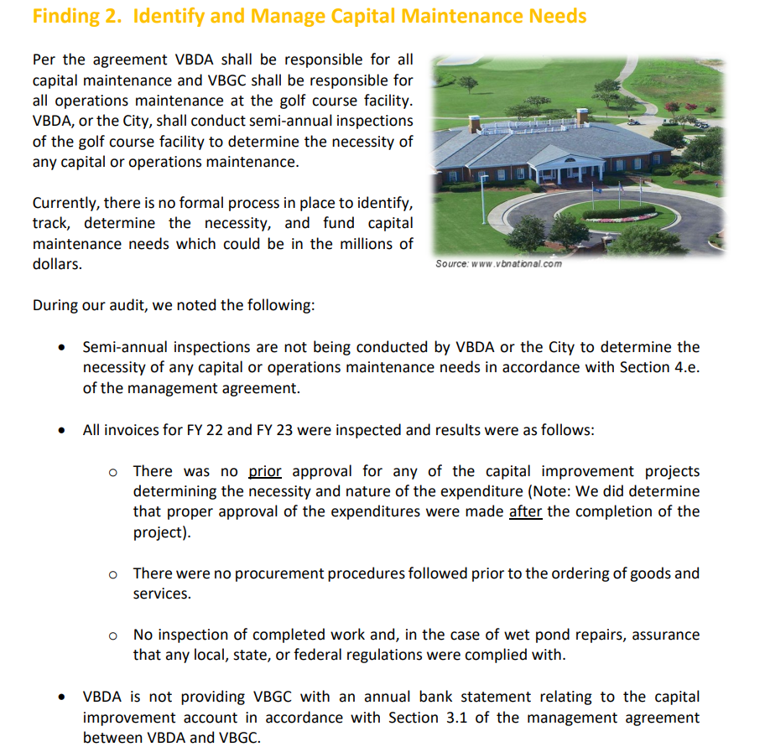

Slide 32
June 16, 2026
Emily Archer, now the Acting Director of the VBDA, presents a slide presentation to all City Council members and the City Manager.

Slide 33
Accept the terms proposed from The Dragas Companies and proceed to a public Hearing on July 7, and a Potential Vote on July 14, now deferred to August 11th.
Maintain status quo with a new operator, continue to defer capital maintenance until funds become available
Other as directed

Slide 34
What are we recommending
City Council do on Aug. 11?
Take a Strategic Pause
Keep VBN and make Necessary repairs
Re-evaluate the RFP. Fair and Equitable?
Public input considered
Do we need to sell it?
Re-issue RFP
Best outcome-VOTE NO!

Slide 35
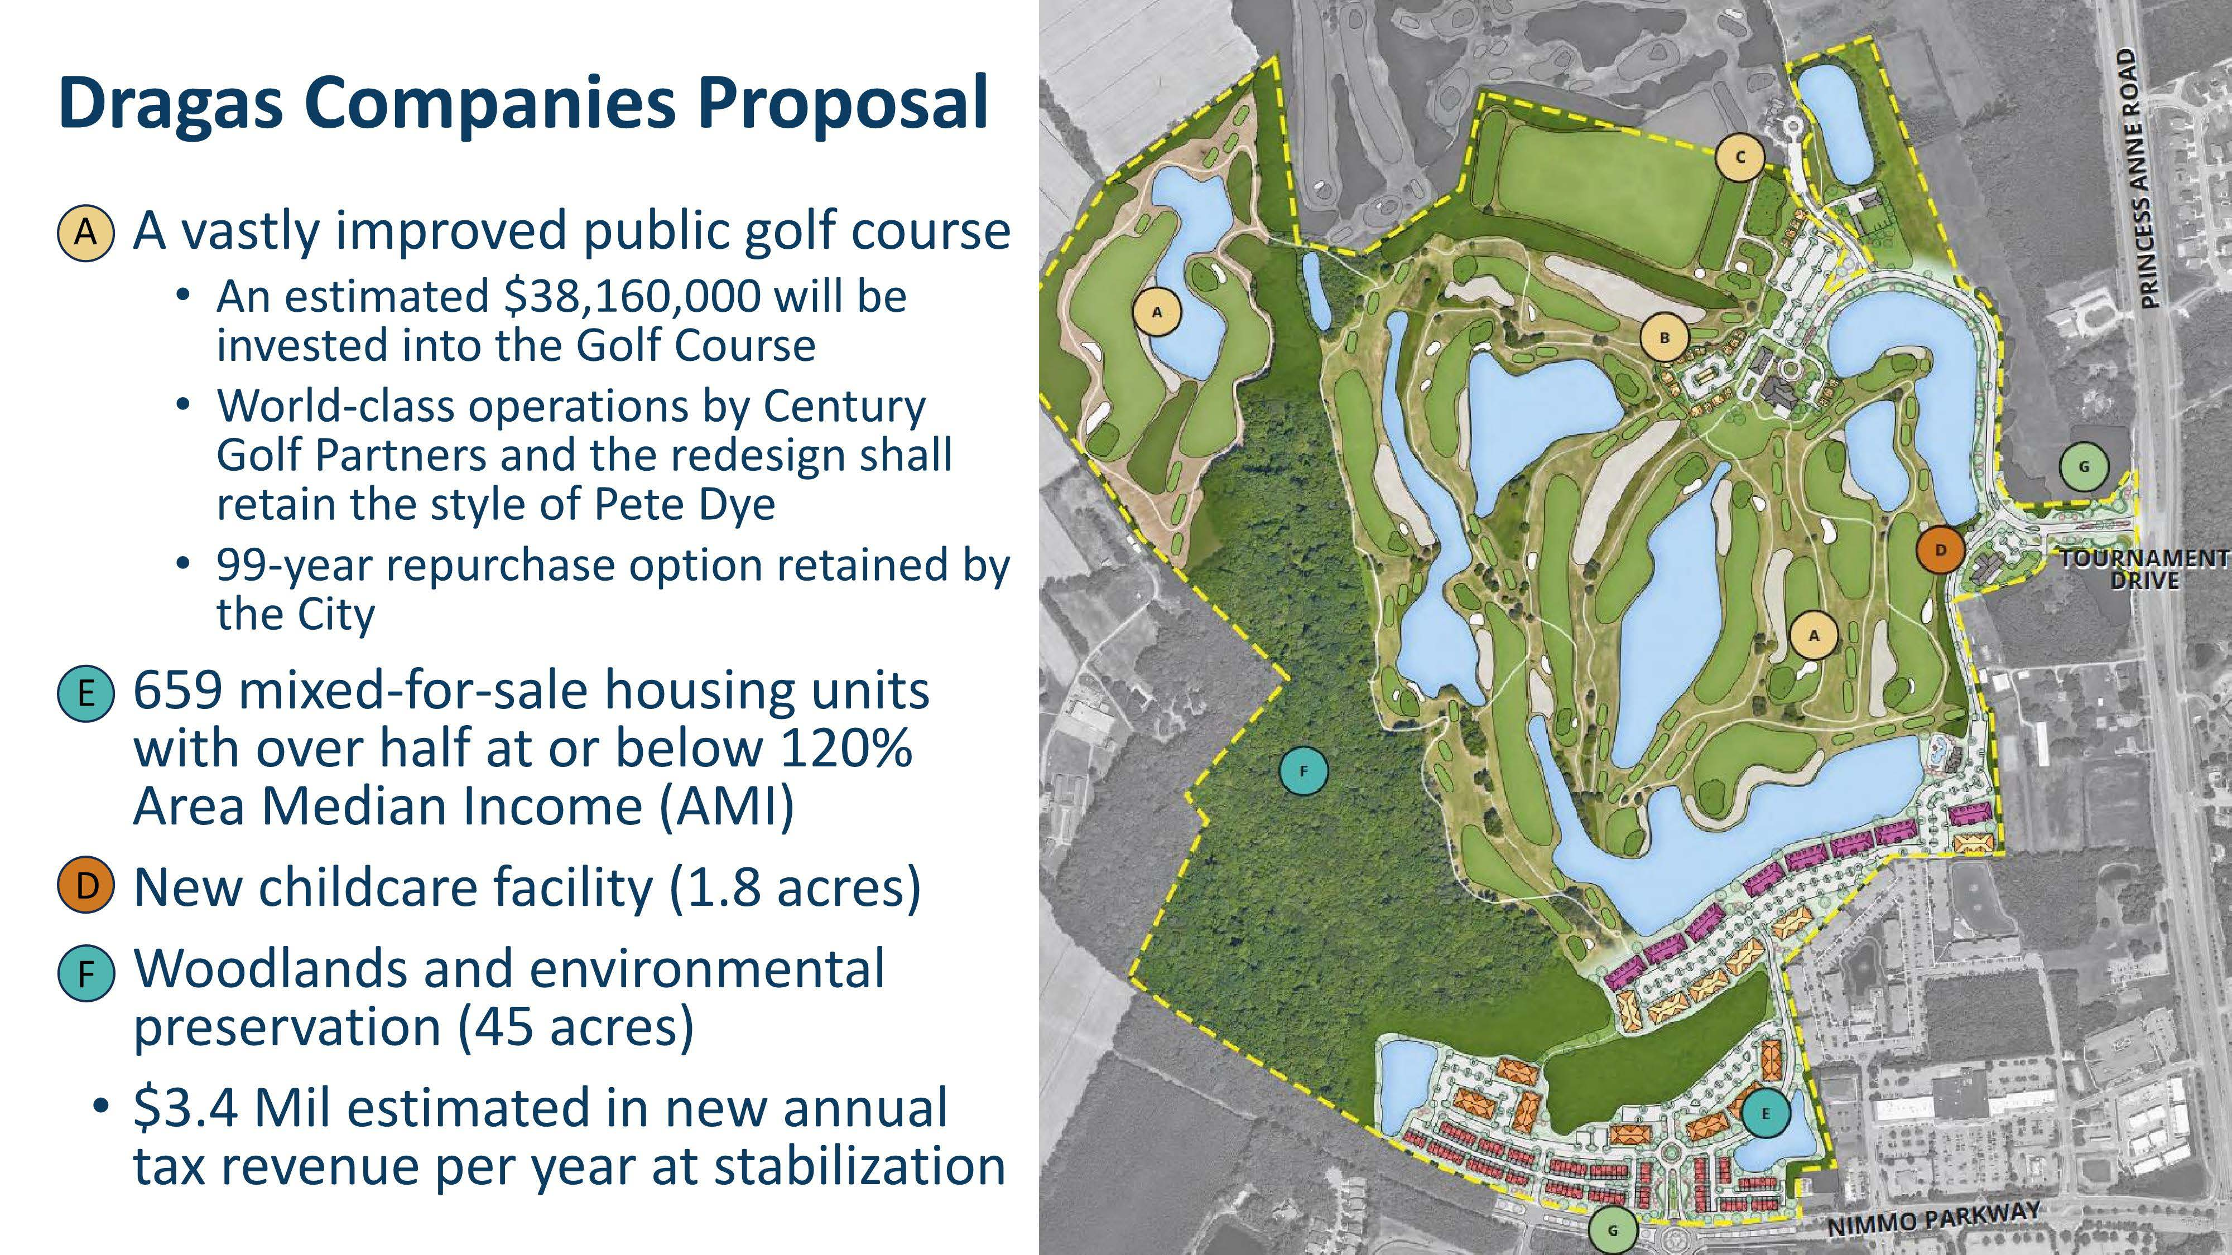

Slide 36
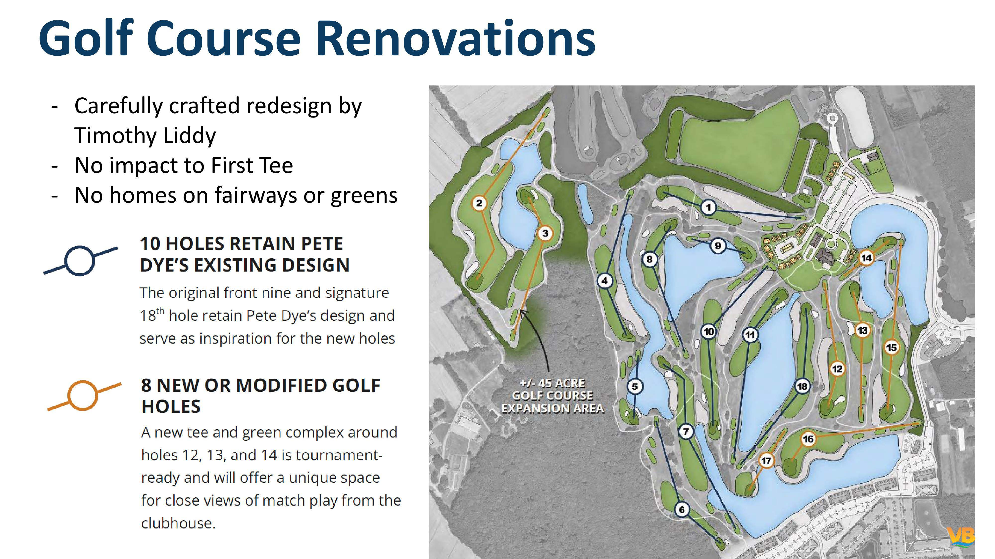
The Dragas Companies

Slide 37
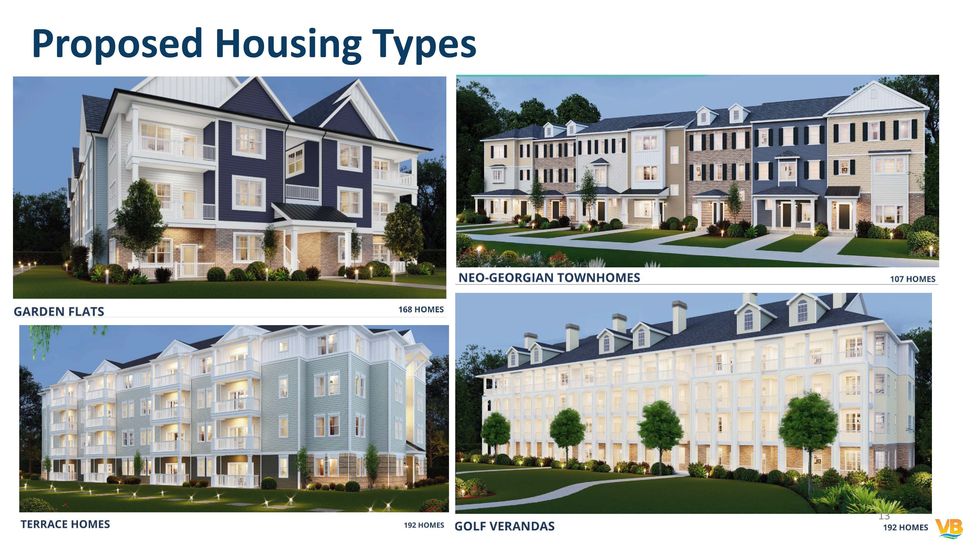
The Dragas Companies

Slide 38
